Slide 2
Recap of the last lecture
Requirements elicitation techniques
  Facilitated techniques
    Interviews
    Workshops
    Focus Groups
    Observations
    Questionnaires
  Independent techniques
    System Interface analysis
    User Interface analysis
    Document analysis

Slide 3
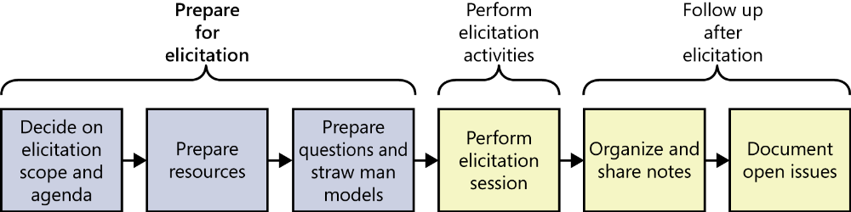
Elicitation Process

Slide 4
1. Preparing for elicitation
Facilitated elicitation sessions require preparation to make the best use of everyone’s time.
The larger the group participating in the session, the more important preparation is.
Plan session scope and agenda
Prepare resources
Learn about the stakeholders
Prepare questions and straw man models

Slide 5
iv. Prepare Questions
What could prevent the user from successfully completing a task?
How should the system respond to various error conditions?
Ask questions that begin with “What else could . . . ,” “What happens when . . . ,” “Would you ever need to . . . ,” “Where do you get . . . ,” “Why do you (or don’t you) . . . ,” and “Does anyone ever . . .”
“What three things annoy you the most about the existing system?”
At the end of your session, ask “Is there anything else you expected me to ask?” to try to surface issues you just didn’t think of.
Document the source of each requirement so that you can obtain further clarification if needed and trace development activities back to specific customer origins.
The prepared questions are to help you if you get stuck.
The questions should seem natural and comfortable—like a conversation, not an interrogation.

Slide 6
iv. Prepare straw man models
Analysis models can be used during elicitation sessions to help users provide better requirements.
  Some of the most useful models are use cases and process flows because they closely align with how people think about doing their jobs.
Create straw man, or draft, models ahead of your elicitation sessions.
A straw man serves as a starting point that helps you learn about the topic and inspires your users to think of ideas.
It is easier to revise a draft model than to create one from scratch.
If you are new to the project’s domain, it might be hard to create a draft model on your own.
  Use other elicitation techniques to glean enough knowledge to work from.
  Read existing documents, examine existing systems for models you can reuse as a starting point, or hold a one-on-one interview with a subject matter expert to learn enough to get started.
  Then tell the group you’re working with, “This model will probably be wrong. Please tear it apart and tell me how it should look. You won’t hurt my feelings.”

Slide 7
Tips for performing facilitated elicitation activities
Educate stakeholders
Take good notes
Exploit the physical space

Slide 8
Following up after elicitation
You need to
  Organizing and sharing the notes
  Documenting open issues

Slide 9
Organizing and sharing the notes
Organizing notes of a facilitated activity probably requires more effort than if you organized information as you encountered it during an independent elicitation activity.
Consolidate your input from multiple sources.
Review and update your notes soon after the session is complete, while the content is still fresh in your mind.
Editing the elicitation notes is a risk.
  You might be incorrectly remembering what something meant, thereby unknowingly changing the meaning
  Keep a set of the raw notes to refer to later if necessary.
  Soon after each interview or workshop, share the consolidated notes with the participants and ask them to review them to ensure that they accurately represent the session.
  Hold additional discussions to resolve any inconsistencies and to fill in any blanks.
  Consider sharing the consolidated notes with other project stakeholders who weren’t present in the session, so that they are aware of progress. This gives them the opportunity to flag any issues or concerns immediately.

Slide 10
Documenting open issues
During elicitation activities, you might have encountered items that need to be further explored at a later date or knowledge gaps you need to close. Or you might have identified new questions while reviewing your notes.
For each issue, record any relevant notes related to resolving the issues, progress already made, an owner, and a due date.
Consider using the same issue-tracking tool that the development and testing teams use.

Slide 11
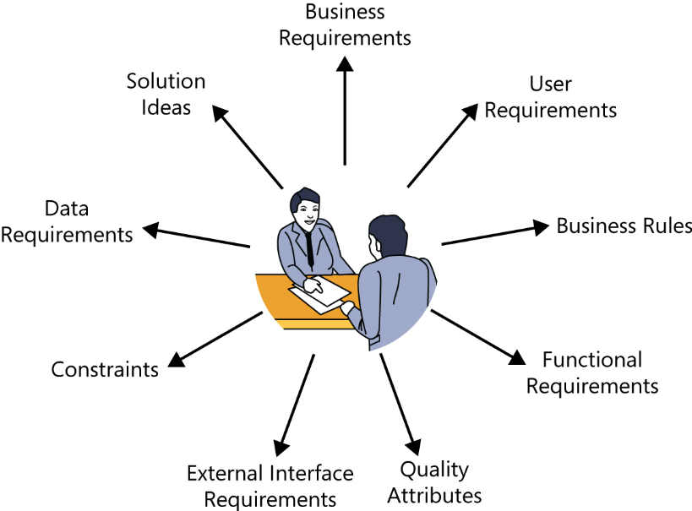
Classifying customer input
Don’t expect your customers to present a succinct, complete, and well-organized list of their needs.
Analysts must classify the myriad bits of requirements information they hear into various categories so that they can document and use it appropriately.

Slide 12
Requirements other than mentioned classes
As with many categorizations, the information gathered might not fit precisely into these nine buckets.
Anything that doesn’t fit into one of these categories might be:
  A project requirement not related to the software development, such as the need to train users on the new system.
  A project constraint, such as a cost or schedule restriction (as opposed to the design or implementation constraints described in this chapter).
  An assumption or a dependency.
  Extraneous information that does not add value.

Slide 13
Business requirements
Anything that describes the financial, marketplace, or other business benefit that either customers or the developing organization wish to gain from the product is a business requirement.
Listen for statements about the value that buyers or users of the software will receive, such as these:
  “Increase market share in region X by Y percent within Z months.”
  “Save $X per year on electricity now wasted by inefficient units.”

Slide 14
User requirements
General statements of user goals or business tasks that users need to perform are user requirements, most typically represented as use cases, scenarios, or user stories
A user who says, “I need to <do something>” is probably describing a user requirement, as in the following examples:
  “I need to print a mailing label for a package.”
  “As the lead machine operator, I need to calibrate the pump controller first thing every morning.”

Slide 15
Business rules
When a customer says that only certain users can perform an activity under specific conditions, he might be presenting a business rule.
These aren’t software requirements as they stand, but you might derive some functional requirements to enforce the rules. Phrases such as “Must comply with . . . ,” “If <some condition is true>, then <something happens>,” or “Must be calculated according to . . . ” suggest that the user is describing a business rule. Here are some examples:
“A new client must pay 30 percent of the estimated consulting fee and travel expenses in advance.”
“Time-off approvals must comply with the company’s HR vacation policy.”

Slide 16
Functional requirements
Functional requirements describe the observable behaviors the system will exhibit under certain conditions and the actions the system will let users take.
Here are some examples of functional requirements as you might hear them from users:
  “If the pressure exceeds 40.0 psi, the high-pressure warning light should come on.”
  “The user must be able to sort the project list in forward and reverse alphabetical order.”
These statements illustrate how users typically present functional requirements, but they don’t represent good ways to write functional requirements.
The

Slide 17
Quality attributes
Statements that describe how well the system does something are quality .
Listen for words that describe desirable system characteristics: fast, easy, user-friendly, reliable, secure.
You’ll need to work with the users to understand just what they mean by these ambiguous and subjective terms so that you can write clear, verifiable quality goals.
The following examples suggest what quality attributes might sound like when described by users:
  “The mobile software must respond quickly to touch commands.”
  “The shopping cart mechanism has to be simple to use so my new customers don’t abandon the purchase.”

Slide 18
External interface requirements
Requirements in this category describe the connections between your system and the rest of the universe.
Phrases such as “Must read signals from . . . ,” “Must send messages to . . . ,” “Must be able to read files in <format>,” and “User interface elements must conform to <a standard>” indicate that the customer is describing an external interface requirement.
Following are some examples:
  “The manufacturing execution system must control the wafer sorter.”
  “The mobile app should send the check image to the bank after I photograph the check I’m depositing.”

Slide 19
Constraints
Design and implementation constraints legitimately restrict the options available to the developer.
Devices with embedded software often must respect physical constraints such as size, weight, and interface connections.
Phrases that indicate that the customer is describing a design or implementation constraint include: “Must be written in <a specific programming language>,” “Cannot exceed <some limit>,” and “Must use <a specific user interface control>.”
The following are examples of constraints that a customer might present:
  “Files submitted electronically cannot exceed 10 MB in size.”
  “The browser must use 256-bit encryption for all secure transactions.”
Ask why the constraint exists, confirm its validity, and record the rationale for including it as a requirement.

Slide 20
Data requirements
Customers are presenting a data requirement whenever they describe the format, data type, allowed values, or default value for a data element; the composition of a complex business data structure; or a report to be generated.
Some examples of data requirements are as follows:
  “The ZIP code has five digits, followed by an optional hyphen and four digits that default to 0000.”
  “An order consists of the customer’s identity, shipping information, and one or more products, each of which includes the product number, number of units, unit price, and total price.”

Slide 21
Solution ideas
Many “requirements” from users are really solution ideas.
Someone who describes a specific way to interact with the system to perform some action is suggesting a solution.
The business analyst needs to probe below the surface of a solution idea to get to the real requirement.
Repeatedly asking “why” the user needs it to work this way will likely reveal the true need.
  For instance, passwords are just one of several possible ways to implement a security requirement.
  “Then I select the state where I want to send the package from a drop-down list.”
  The prudent BA will ask, “Why from a drop-down list?” If the user replies, “That just seemed like a good way to do it,” then the real requirement is something like, “The system shall permit the user to specify the state where he wants to send the package.”
  But maybe the user says, “We do the same thing in several other places and I want it to be consistent. Also, the drop-down list prevents the user from entering invalid data.”
  These are legitimate reasons to specify a specific solution.
Recognize, though, that embedding a solution in a requirement imposes a design constraint on that requirement: it limits the requirement to being implemented in only one way. This isn’t necessarily wrong or bad; just make sure the constraint is there for a good reason.

Slide 22
How to tell that elicitation is over
No simple signal will indicate when you’ve completed requirements elicitation.
Perhaps you are done if:
  The users can’t think of any more use cases or user stories. Users propose new scenarios, but they don’t lead to any new functional requirements. A “new” use case might really be an alternative flow for a use case you’ve already captured.
  Users repeat issues they already covered in previous discussions.
  Suggested new features, user requirements, or functional requirements are all deemed to be out of scope.
  The users are proposing capabilities that might be included “sometime in the lifetime of the product” rather than “in the specific product we’re talking about right now.”
  Developers and testers who review the requirements for an area raise few questions.

Slide 23
Some cautions about elicitation
Balance stakeholder representation
Define scope appropriately
Avoid the requirements-versus-design argument
Research within reason
Assumed and implied requirements

